Slide 1


Capstone Project Ezekiel Kuang

Slide 2


“Click Or Click Not…
There Is No Try”

Slide 3

Motivation
Goals
Success Metrics
Data
Approach and Modelling
Findings
Limitations
Impact and Conclusions
Notes:
Machine translation: Natural language processing is increasingly being used for machine translation programs, in which one human language is automatically translated into another human language.
Named entity extraction: In data mining, a named entity definition is a phrase or word that clearly identifies one item from a set of other items that have similar attributes. Examples include first and last names, age, geographic locations, addresses, phone numbers, email addresses, company names, etc. Named entity extraction, sometimes also called named entity recognition, makes it easier to mine data.
Co-reference resolution: In a chunk of text, co-reference resolution can be used to determine which words are used to refer to the same objects.
Automatic summarization: Natural language processing can be used to produce a readable summary from a large chunk of text. For example, one might us automatic summarization to produce a short summary of a dense academic article.

Slide 4
Motivation
In the digital era, anyone can write and publish content online
Content proliferation has led to a rampant increase in the amount of clickbait
Notes:
https://marketinginsidergroup.com/content-marketing/what-you-need-to-know-headlines-clickbaits/

Slide 5


Slide 6
Goals
Predict whether an article was clickbait or not,
without having to read through the article manually

Slide 7

Success Metrics
What % of all clickbait articles were tagged correctly?
 | Clickbait (predicted) | Not Clickbait (predicted)
Clickbait (Actual) | True Positive | False Negative
Not Clickbait (Actual) | False Positive | True Negative
TP
TP + FN
Recall =

Slide 8
Approach and Modelling
Break down text articles into words
Train model to recognise words associated with clickbait
Predict whether article is clickbait
(output 1 or 0)

Slide 9
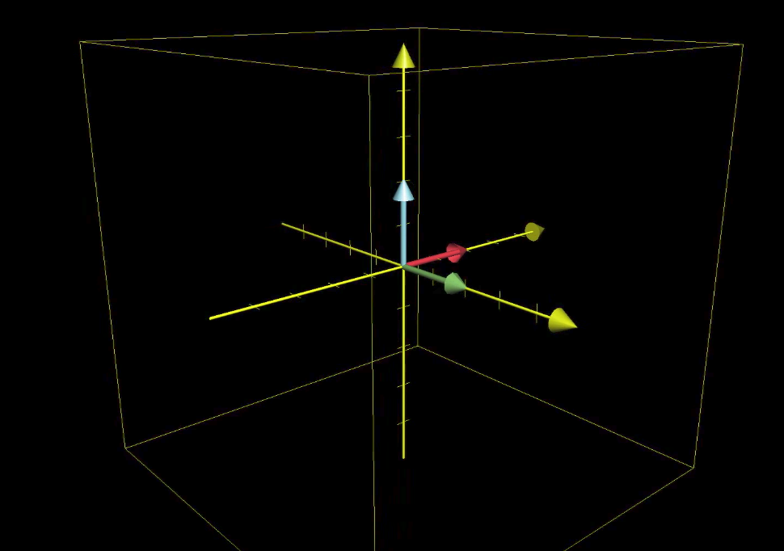
King (0.3x, 0.5y, 0.8z)
Queen (0.3x, 0.6y, 0.9z)
Appendix

Slide 10
Approach and Modelling
Classification problem
Simple Classifiers
Log Regression
SVMs
Neural Networks
LSTM RNN
Naive Bayes
Random Forest

Slide 11
Findings
Highest recall score of 0.71 under Naïve Bayes model
Use of LSTM RNNs improved accuracy score to 0.82

Slide 12
Findings – Correctly Predicted as Clickbait
Katy Perry new song 2017: You can listen to ‘Chained to the Rhythm’ now but you’ll have to work for it
Disco ball players have been installed around the world. Every pop star knows the protocol by now: drop a track out of nowhere, everyone rushes to listen to it, watch it go viral. Katy Perry is going for a more traditional experience for her new single ‘Chained to the Rhythm’ though, in a sense, by restricting first listens to people who seek them out. Because she can, Perry has had disco balls scattered throughout the world that double as players of the song, which passers-by can plug their headphones into. "Of COURSE I'm gonna go hike up to that disco ball to hear the new @katyperry!” #ChainedToTheRhythm pic.twitter.com/d0hJOL4ov5 Picture says it all bro @katyperry #ChainedToTheRhythm pic.twitter.com/RtluRZMWx8 …
<bunch of other twitter comments>…

Slide 13
Findings – Wrongly Predicted as Clickbait
Check Out the Most Popular Netflix Show in Each State
“Netflix's viewer numbers are a closely guarded secret. But at least one website has come up with a plausible way to figure out which of the service's shows people are watching in different states. The site HighSpeedInternet looked at 75 of Netflix's top shows (they have shows?), cross referenced with information from Google Trends, and voila kinda-sorta-plausible way to determine the most popular Netflix show in each state…”
“New York -- a study released by the university of southern california reports that roughly nine to 15 percent of twitter accounts on the microblogging website are so-called bots controlled by software instead of humans. twitter boasts 319 monthly active users meaning that this recent revelation equates to nearly 48 million bot accounts, according to the university's high-end figure…”
Study reveals whopping 48M Twitter accounts are actually bots

Slide 14

Findings – Wrongly Predicted as Non-Clickbait
Cop In Madhya Pradesh Gets Thrashed Brutally For Issuing A Fine To A BJP Leader's Relatives
“Back in the day, when Orwell wrote the legendary Animal Farm, little did he know that his prediction will come true and the consequences will be too dangerous for us all. Today, close to 7 decades after his death, we stand staring at a scenario where everyone's equal, but some people are more equal than others. The most recent case in point is the brutal thrashing of a cop in Madhya Pradesh. His crime was that he thought of issuing a fine to a politician's relatives. The constable was thrown on the ground, punched, kicked and repeatedly beaten by a group of 4-5 men, as spectators watched. The gang included… <long story>… “
“manchester coroner complains about inconsistencies in evidence of officers, who held down john ahmed three times in mistaken belief he had taken drugs a prisoner died after he was unlawfully restrained by prison officers in manchester, an inquest has found… <long story>… “
Prison officers acted unlawfully in restraining inmate who later died

Slide 15
Limitations & Conclusions
Text preprocessing is tedious. Hard to achieve zero-errors
Small corpus of text for model to train on
Models are not perfect. Even neural networks have their limitations

Slide 16


The End
Now we are all officially unemployed…

Slide 17
Appendix

Slide 18
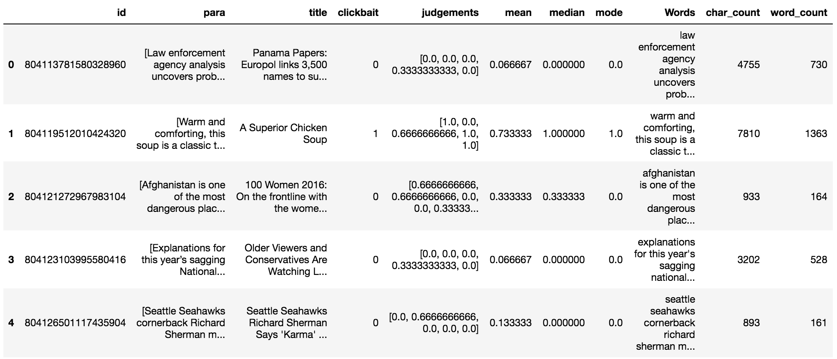
Data

Slide 19
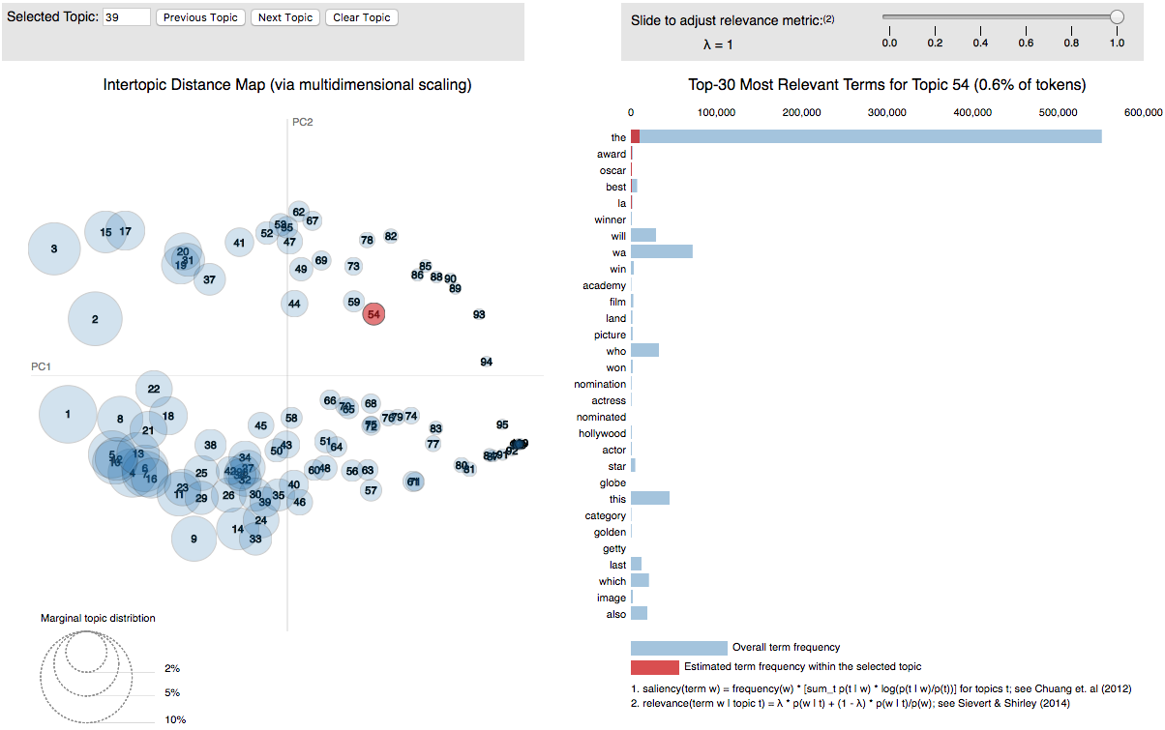
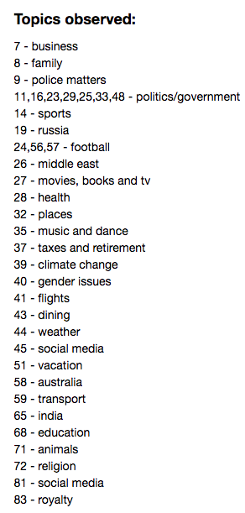
Topic Modeling

Slide 20

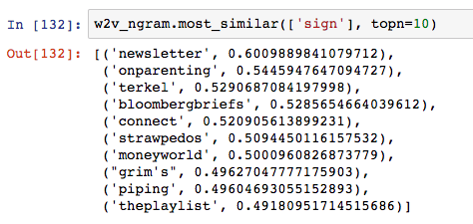
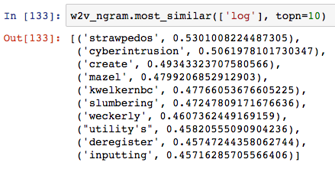
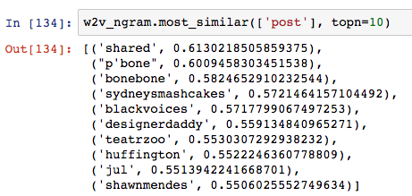
Word2Vec Implementation

Slide 21
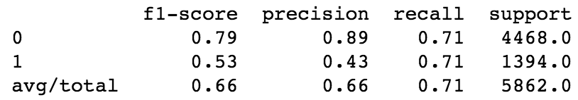
Findings
Unigram Multinomial NB
Balancing the dataset achieved the highest recall score of 0.71 under Naïve Bayes (multinomial) model

Slide 22
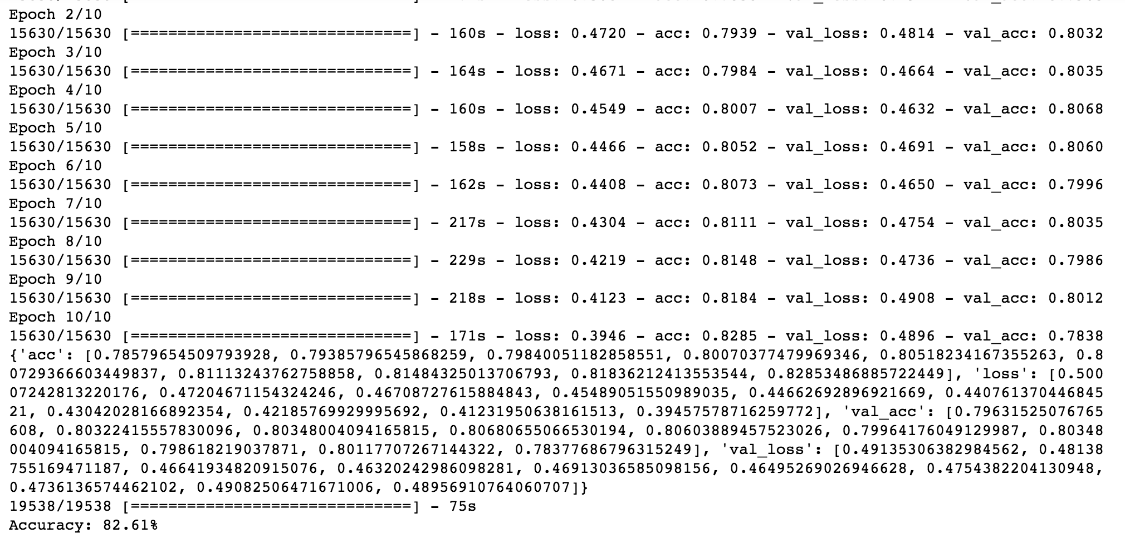
Findings
LSTM: 128 cells, 1 Dense output, sigmoid activation
Use of LSTM RNNs improved accuracy score to 0.82, but model is easily overtrained

Slide 23
Findings

Slide 24
Findings

